Slide 1
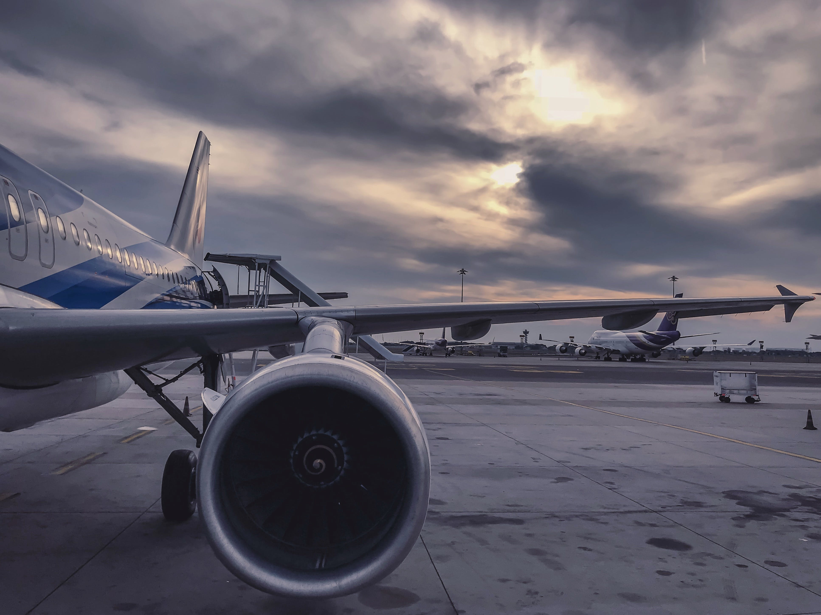
DSCI 5360 – Data Visualization for Analytics. Project on Airlines Pricing
Prudhvi Addada

Slide 2
INTRODUCTION
Purpose:
Learn Visualization Techniques: Understand and apply advanced visualization techniques.
Insight Generation: Gain insights into airline pricing, trends, and dynamics.
Recommendations: Suggest actionable recommendations for airlines, fares, and optimal routes.
Objectives:
Visualization Learning: Explore diverse visualization techniques for comprehensive learning.
Insightful Analysis: Derive meaningful insights into airline pricing patterns and trends.
Actionable Recommendations: Provide practical recommendations for airlines, fares, and route optimization based on data analysis.

Slide 3
DATASET
Data Collection: Kaggle user: "SHRAY GARG"
Size of the Data: 11 Fields, 10.7K Cases
Year : 2019
Data Preprocessing Steps:
1. Cleaning: Handle missing or inconsistent data.
2. Transformation: Convert date and time formats for analysis.
Important field name: Airline, Date_of_Journey, Source, Destination, Route, Dep_Time, Arrival_Time, Duration, Total_Stops,additional Info etc.

Slide 4
GOALS
Analyze monthly variations in flight counts
Determine the airline that excels in fare performance.
Investigate if there's a significant difference in flight counts and fares between weekdays and weekends.
Identify the airline leading in terms of overall revenue.
Explore variations in flight counts and fares across different stops.
Determine the average fares for flights on popular airlines.
Determine the number of flights and best airline arriving at the destination from specific sources.

Slide 5
VISUALIZATION
What are the top 5 airlines with the highest flight counts?
What was the trend in flight counts from March to June 2019, and were there any notable fluctuations or patterns monthly?
Which airline tops in fare performance that contribute to high profits?
Is there a significant difference in airline traffic patterns and fares between weekdays and weekends

Slide 6
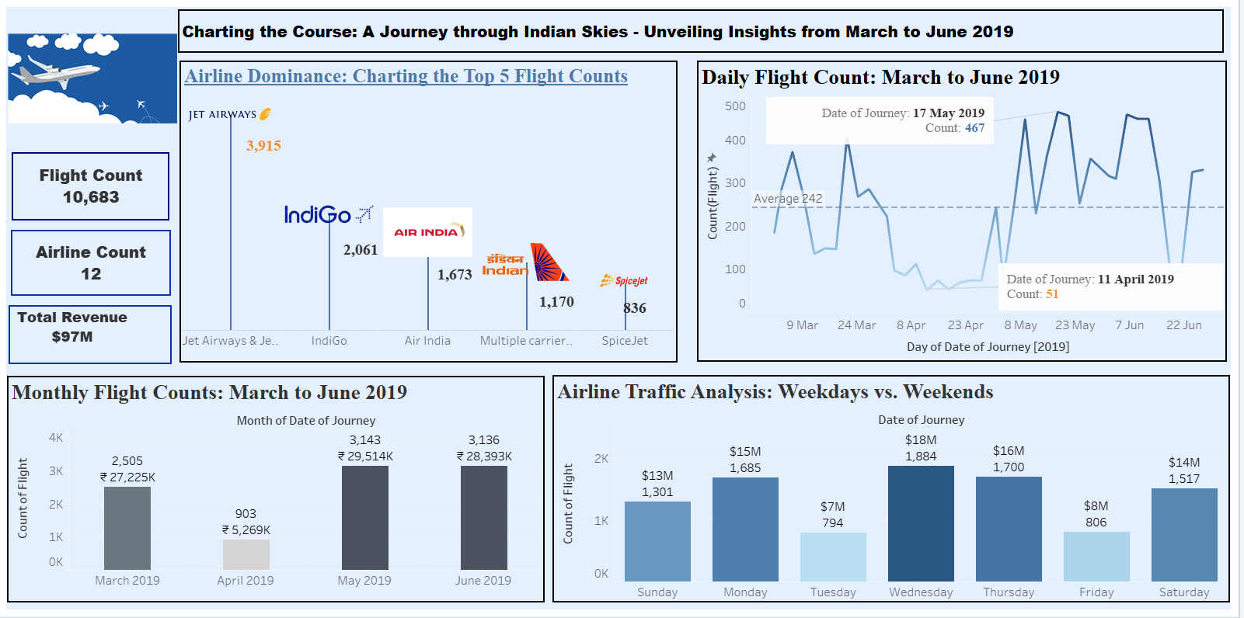

Slide 7
VISUALIZATION
Which airline tops in the airline revenue?
How do flight count and fares vary across different stops, and what insights can be gained from this stop-by-stop breakdown?
What are the average fares for airlines on popular Airlines and on multiple stops?

Slide 8
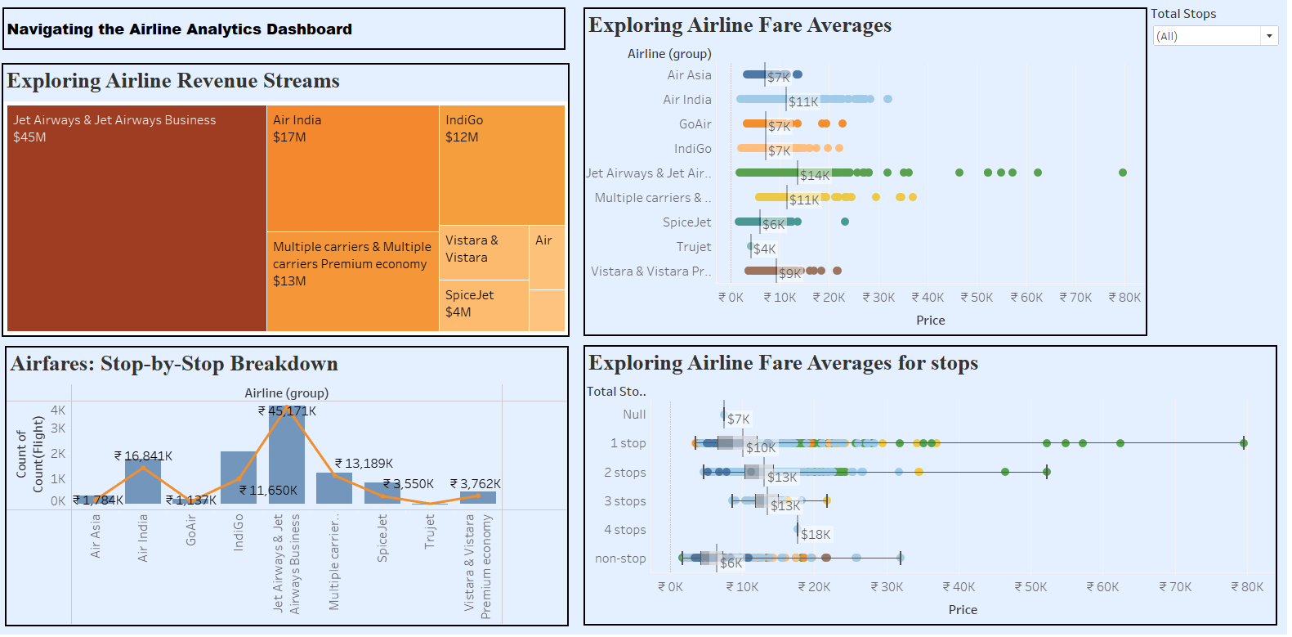

Slide 9
VISUALIZATION
How many flights arrive at the destination from the source?
What is the average fare for flights from Source to Destination?

Slide 10
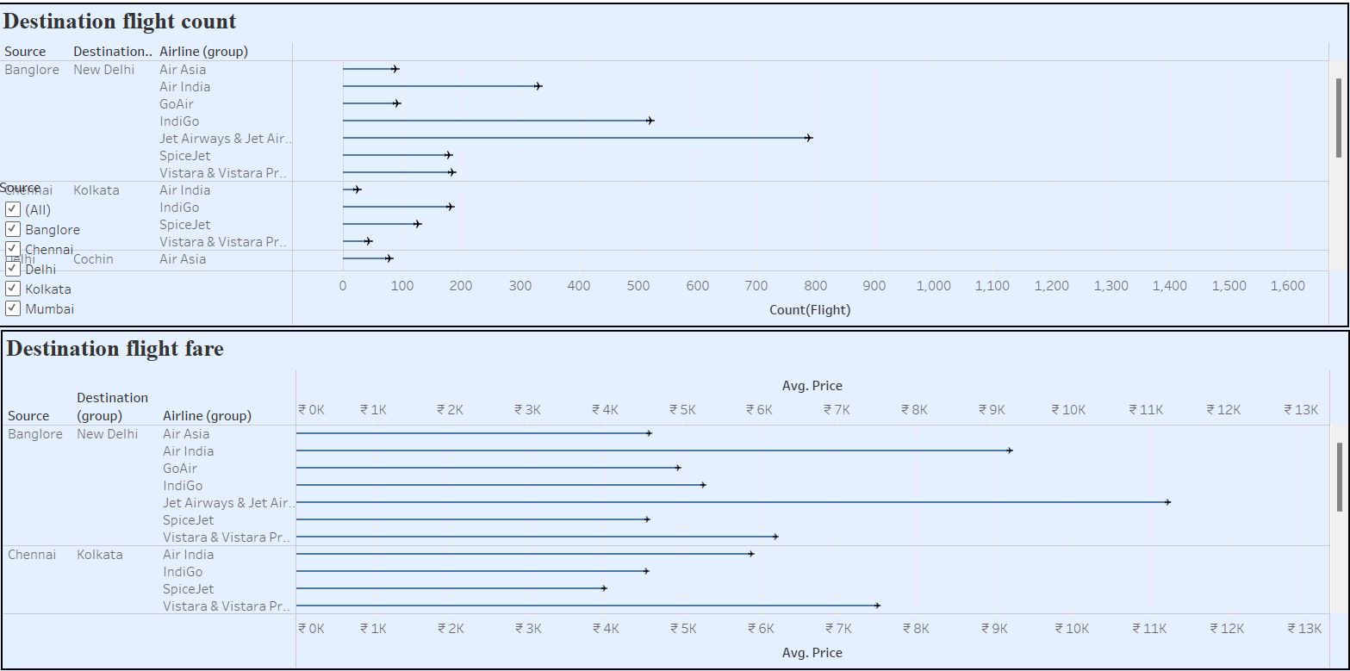

Slide 11
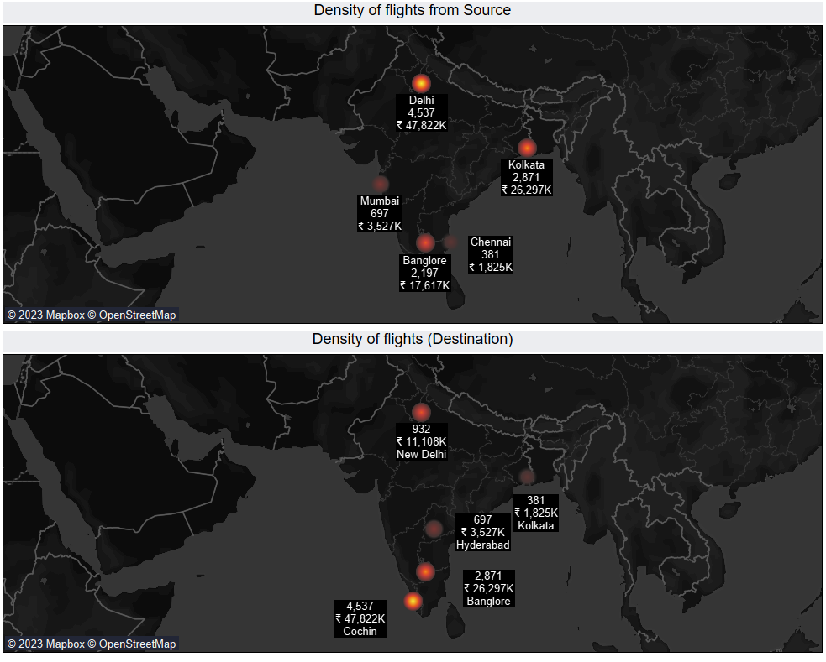

Slide 12
CONCLUSION
Revenue Analysis:
Identified top-performing flights based on revenue.
Analyzed revenue distribution to understand key contributors.
Flight Count Insights:
Explored the frequency of flights to determine popular destinations.
Best Flight Selection:
Evaluated criteria for the "best" flight, considering both revenue and count.
Affordability Analysis:
Investigated and highlighted affordable flight options.
Temporal Trends:
Analyzed trends in flight counts for March, April, May, and June.
Explored variations in flight schedules between weekdays and weekends.

Slide 13
Limitations of the dataset
The data only covers flights within India. Analysing international routes could reveal different pricing dynamics.
There are a limited number of airlines represented in the data (Air India, GoAir, IndiGo, etc). Including more airlines would allow for comparison across a wider set of competitors.
The data does not include some variables that could impact pricing, like cabin class, peak vs off-peak travel times, group bookings, etc. Adding these variables could uncover additional factors influencing airfares.

Slide 14

THANK YOU

